Slide 1
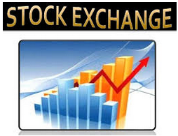
Lecture 7. The stock exchange
COURSE
STOCK EXCHANGE MARKET
V. Yavorska,
PhD in economics, associate professor of the Department of exchange activities and trade NULES of Ukraine

Slide 2
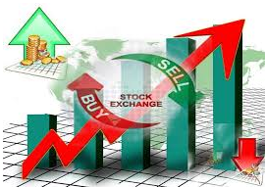
Plan:
1. The stock exchange. 2. Tasks and functions of the stock exchange. 3. Structure of the stock exchange. 4. Organization of trading on the stock exchange. 5. The procedure of listing.

Slide 4
Functions of stock exchange

Slide 5
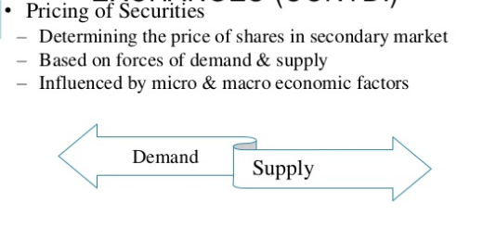
Functions of stock exchange

Slide 6
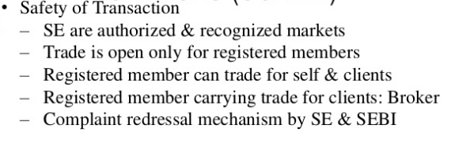
Functions of stock exchange

Slide 7
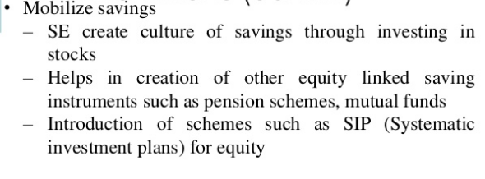
Functions of stock exchange

Slide 8
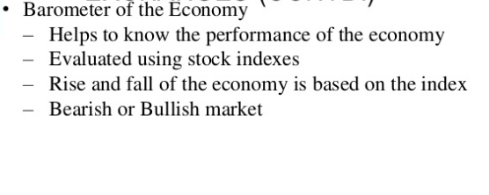
Functions of stock exchange

Slide 9
ЗАКОН УКРАЇНИ “ПРО ЦІННІ ПАПЕРИ ТА ФОНДОВИЙ РИНОК”
Фондова біржа утворюється не менше ніж 20 засновниками
Фондова біржа набуває статусу юридичної особи з моменту державної реєстрації.
Діяльність фондової біржі зупиняється Національною комісією з цінних паперів та фондового ринку, якщо кількість її членів стала меншою за 20.

Slide 10
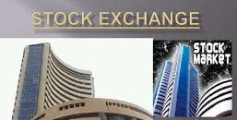
Tasks and functions performed by the stock exchange concerning various spheres of society, so they can be distributed as follows.

Slide 11
In the economic sector:
circulation of excess capital
movement of capital in a more efficient industry
accumulation of free cash flow
regulation of securities
actual value of fixed assets

Slide 12
In the financial sector:
determining the market price of securities
organization of settlements on concluded agreements
providing operational information to market participants about the financial state of the market

Slide 13
In the political sphere:
promote the strengthening of economic independence
accelerating integration processes
access to the world market

Slide 14
In the social sphere:
increase welfare by reallocating funds
creation of new jobs through the investment process

Slide 15
In the moral-psychological sphere:
Formation of market psychology in the population
Formation of confidence in securities and transactions with them
prevent abuse and fraud in the stock market

Slide 16
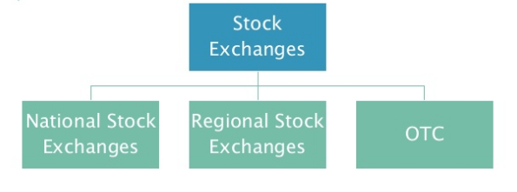
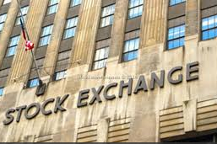

Slide 17
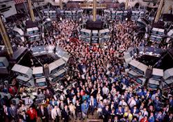
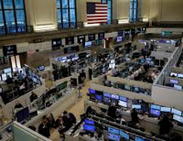

Slide 18
stock exchange COMMITTEE
General
Special

Slide 19
The process of trading is defined trading rules of each exchange, but usually it involves the following steps:
• collect of buyer and seller requests the purchase and sale of securities;
• transfer to the broker bank guarantee from buyer;
• transfer of securities to the broker by the seller;
• signing a contract;
• check the parameters of the agreement;
• transfer of securities and money.

Slide 20
RESOURSES: 1. Закон України "Про цінні папери та фондовий ринок". http://zakon2.rada.gov.ua/laws/show/3264-17 2. Ukrainian Exchange. http://www.ux.ua.

