Slide 1
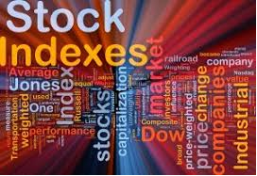
Course Stock Exchange Market Lecture 8. The stock indices
V. Yavorska,
PhD in economics, associate professor of the Department of exchange activities and trade NULES of Ukraine

Slide 2
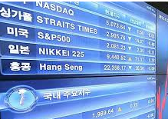
Plan:
8.1. History and characteristics of stock index.
8.2. The main functions of stock indices.
8.3. Major stock indices of Ukraine.

Slide 3
Stock Exchange Index - a statistical average value calculated based on the exchange rate difference of securities included in the stock basket.

Slide 7
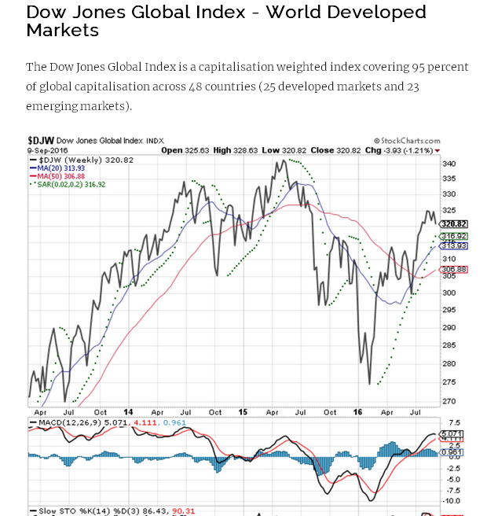

Slide 8
Functions of stock indices
1) diagnostics; 1) Indicative; 3) speculative.

Slide 9
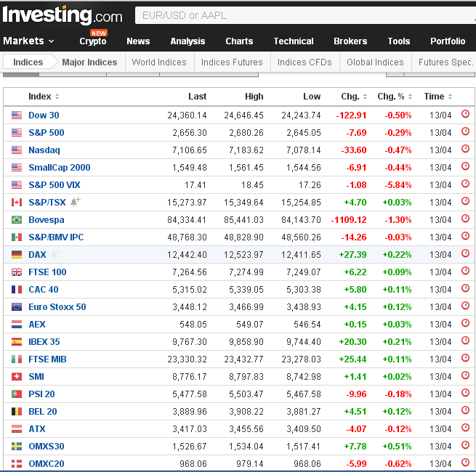

Slide 10
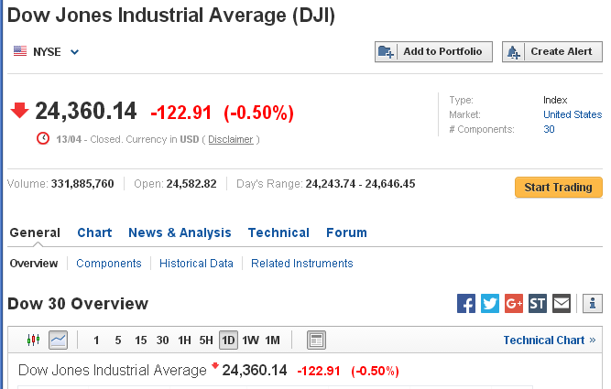

Slide 11
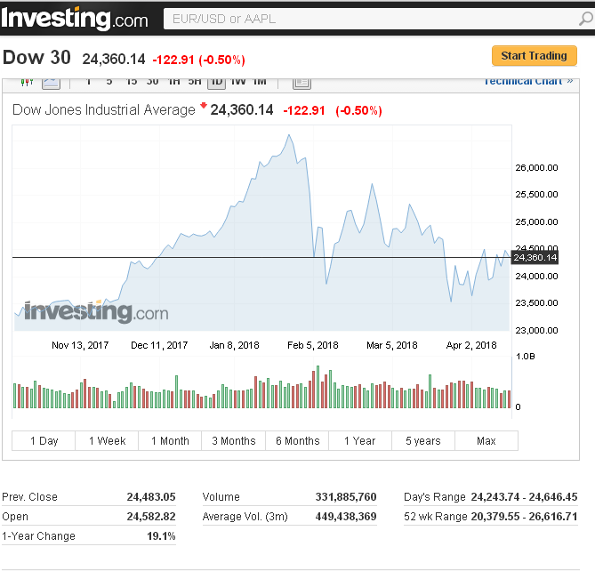

Slide 12
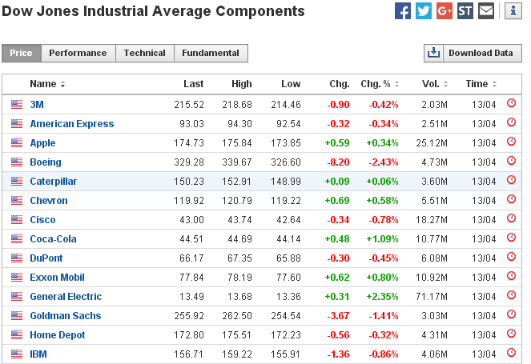
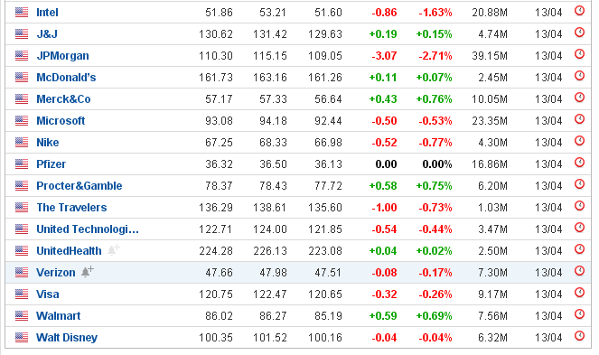

Slide 13
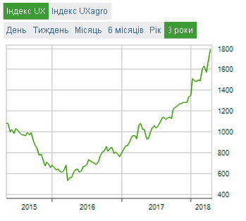

Slide 14
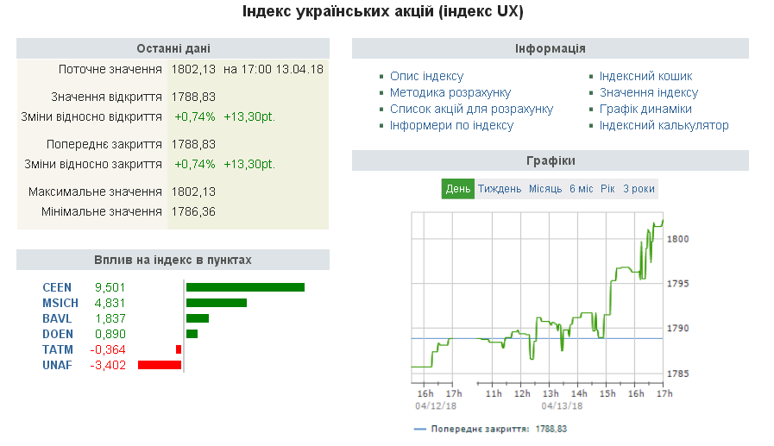

Slide 15
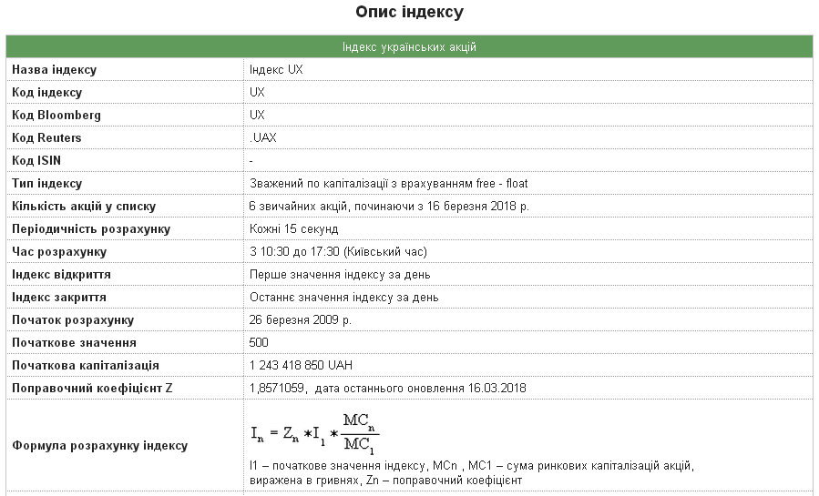

Slide 16
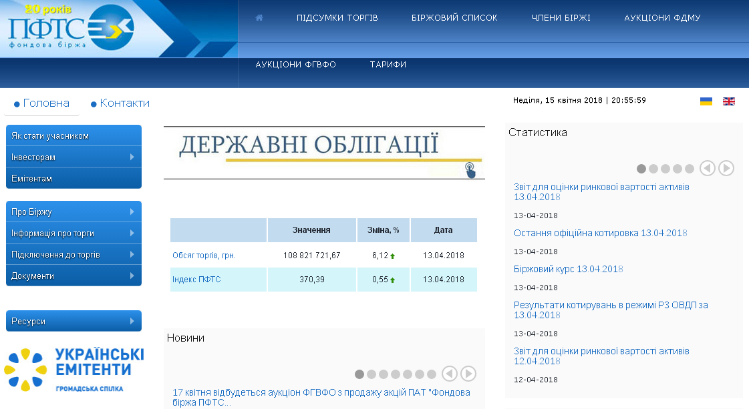

Slide 17
RESOURSES: 1. Major World Indices/ - Електронний ресурс. – Режим доступу:https://www.investing.com/indices/major-indices 2. Ukrainian Exchange. http://www.ux.ua. 3. Index Investing: What Is An Index? - Електронний ресурс. – Режим доступу: https://www.investopedia.com/university/indexes/index1.asp

