Slide 1

Lecture 6. Professional activities in the stock exchange market
COURSE
STOCK EXCHANGE MARKET
V. Yavorska,
PhD in economics, associate professor of the Department of exchange activities and trade NULES of Ukraine

Slide 2
Plan:
1. Underwriting activity in the stock market.
2. The Commission and commercial activities in the stock market.
3. Day-trading.
4. Internet trading securities.

Slide 3


Slide 4
Underwriting is the placement of securities by a trader of securities on behalf of and at the expense of the issuer.
Закон України “Про цінні папери та фондовий ринок”

Slide 5
In general the complex of underwriting services include:
consultation of the issuer
purchase of part of securities or total
placement of issued securities

Slide 6
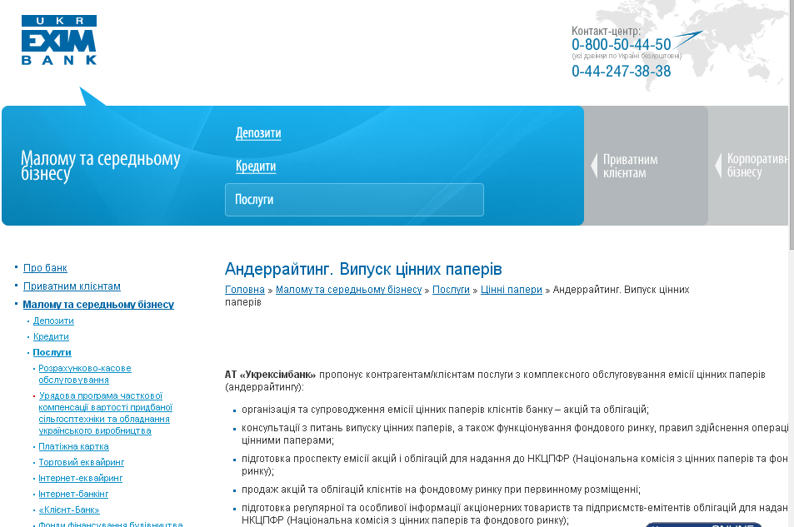

Slide 7
The difference between the two prices is called the underwriting discount.

Slide 8
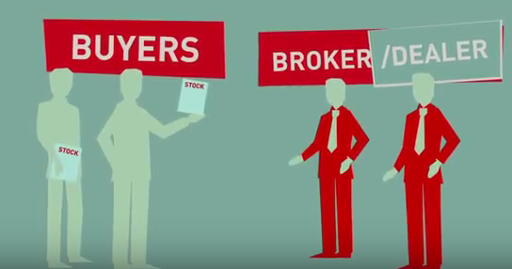

Slide 9

Brokering activities - activities aimed at the conclusion of securities transactions based on contracts commission.

Slide 10
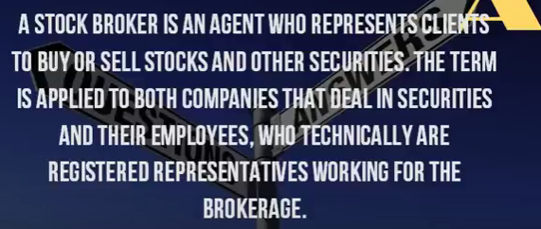

Slide 11
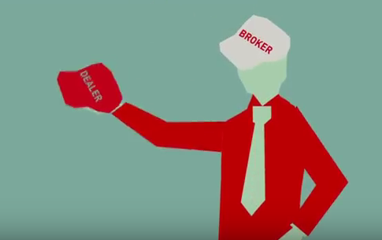

Slide 12
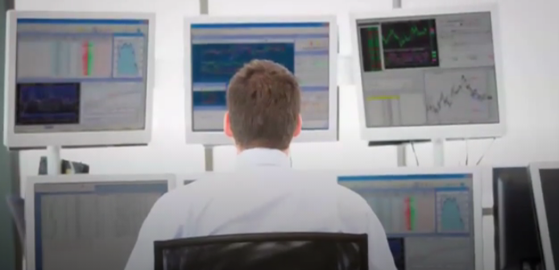
Day trading – the act of buying and selling a financial instrument within the same day.

Slide 13
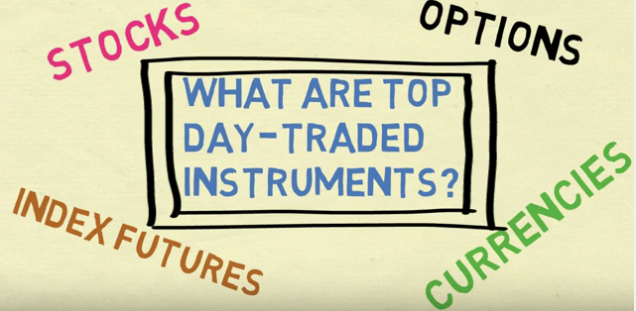

Slide 14
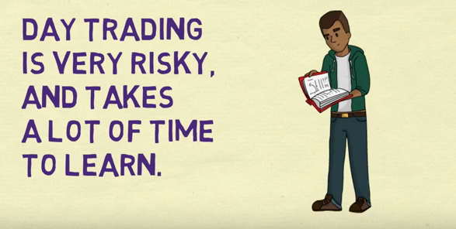

Slide 15
Day Trading Tips You Need to Know
1) Knowledge is Power
2) Set an Amount Aside
3) Set Aside Time, Too
4) Start Small
5) Avoid Penny Stocks
6) Time Those Trades
7) Cut Losses with Limit Orders
8) Be Realistic About Profits
9) Stay Cool…
10) …And Stick to The Plan[3]

Slide 16

Internet trading facilitates purchases and sales of securities on the stock exchange in the real-time mode through universal brokerage system interface and allows for instantaneous response to changes in market conditions, without the need to directly connect to the broker.

Slide 17
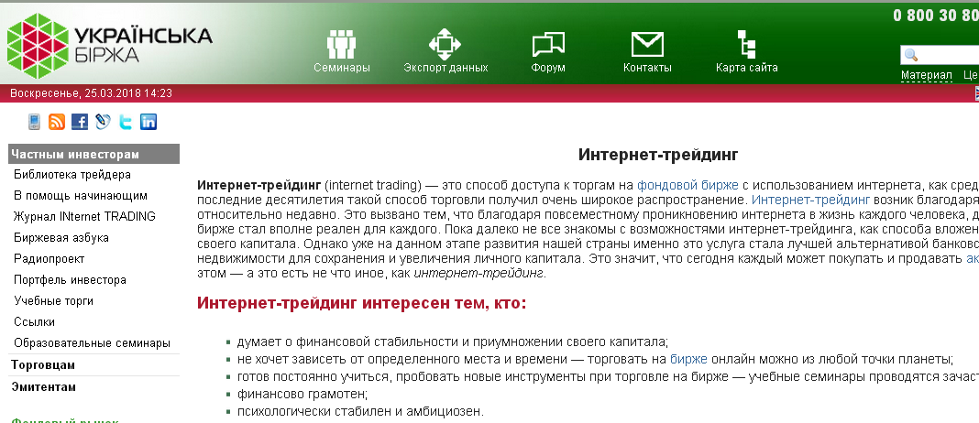
The emergence of Internet trading in Ukraine
Some even now represent the stock exchange in the form of an "exchange pit" - a large hall where men emotionally waving some papers and showing each other something on their fingers.
In 2009, after the launch of the Ukrainian Exchange, Internet trading appeared in Ukraine.

Slide 18
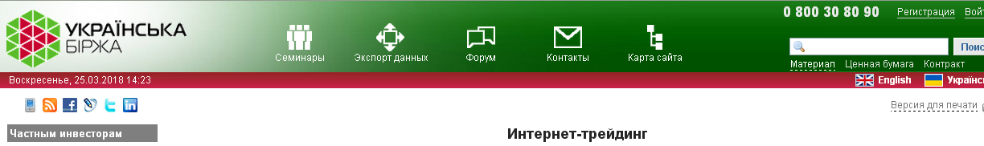
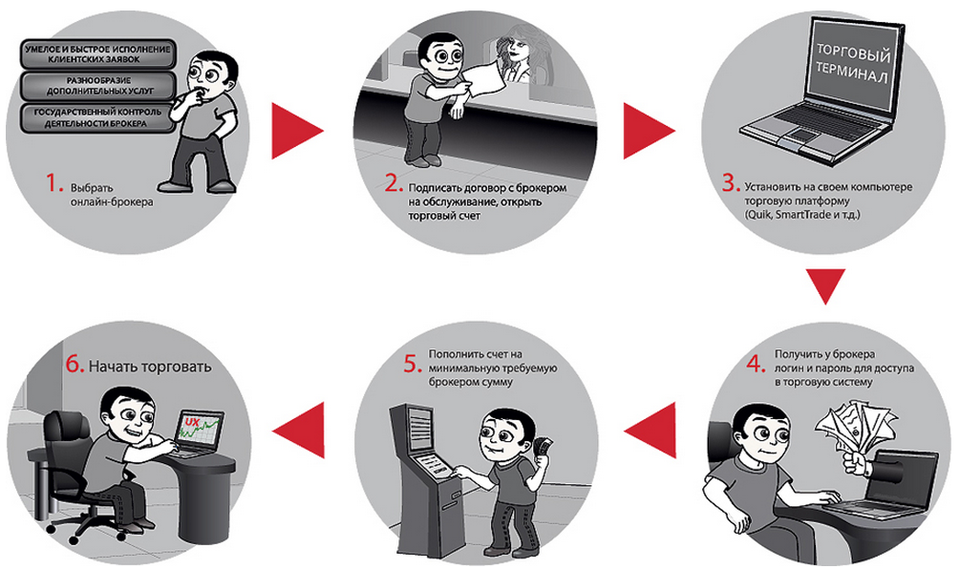

Slide 19
RESOURSES:
1. Закон України "Про цінні папери та фондовий ринок". http://zakon2.rada.gov.ua/laws/show/3264-17
2. Сайт Укрексімбанка. www.eximb.com/ukr/sme/everyday/securities/underwriting/underwriting-details/
3. Day Trading Strategies For Beginners https://www.investopedia.com/articles/trading/06/daytradingretail.asp#ixzz5Akz6xXrR.
4. http://artcapital.ua/en/intrade/trading.
5. Ukrainian Exchange. http://www.ux.ua.

