Slide 1
Інноваційний розвиток України - основа формування біоекономіки
Butenko Vira
National University of Life and Environmental Sciences of Ukraine

Slide 2
Питання
1. Інноваційна політика розвитку біоекономіки у країнах Європейського Союзу
2. Інноваційна основа розвитку біоекономіки
3. Розрахунок індексу інвестиційної привабливості

Slide 3
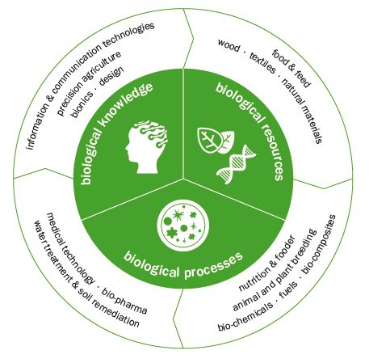
BIOECONOMY
Butenko V.

Slide 4
Development the bioeconomy in EU
Horizon 2020 is the biggest EU Research and Innovation program ever with nearly €80 billion of funding available over 7 years (2014 to 2020) – in addition to the private investment that this money will attract. It promises more breakthroughs, discoveries and world-firsts by taking great ideas from the lab to the market [1].
Innovative, Sustainable and inclusive Bioeconomy. Program EU [2]
The European Knowledge Based Bio-Economy (KBBE). Research Directorate-General European Commission DG RTD-E Biotechnology, Agriculture and Food [3]
Innovating for Sustainable Growth: A Bioeconomy for Europe. STRATEGY FOR "INNOVATING FOR SUSTAINABLE GROWTH: A BIOECONOMY FOR EUROPE“[4]
1.Horizon 2020. Program -http://ec.europa.eu/programmes/horizon2020
2. https://ec.europa.eu/programmes/horizon2020/en/news/innovative-sustinable-and-inclusive-bioeconomy-4
3. https://ec.europa.eu/.../eu.../hallen_19_july_10-45_en.pdf
4. ec.europa.eu/research/bioeconomy/.../official-strategy_ean.pd..

Slide 5
INNOVATION
Innovation can be defined simply as a "new idea, device or method".
However, innovation is often also viewed as the application of better solutions that meet new requirements, unarticulated needs, or existing market needs. Such innovation takes place through the provision of more-effective products, processes, services, technologies, or business models that are made available to markets, governments and society.
The term "innovation" can be defined as something original and more effective.

Slide 6
The Global Innovation Index 2017: Innovation Feeding the World is the result of a collaboration between Cornell University, INSEAD, and the World Intellectual Property Organization (WIPO) as co-publishers, and their Knowledge Partners

Slide 7
THE GLOBAL INNOVATION INDEX of UKRAINE

Slide 8
The rating of Ukraine under the subindices of the indicator "Institutions" and their significance

Slide 9
The rating of Ukraine under the subindices of the indicator "Human capital & research " and their significance

Slide 10
R&D costs in the of GDP, %

Slide 11
The rating of Ukraine under the subindices of the indicator "Market sophistication " and their significance
 | 2011 | 2012 | 2013 | 2014 | 2015 | 2016 | 2017
Market sophistication | 39,6 | 38,7 | 44 | 45,1 | 43,9 | 42,1 | 43,2
Credit | 41,2 | 33,1 | 35,9 | 36,1 | 33,3 | 34,7 | 32,4
Investment | 23,1 | 18,6 | 19,3 | 23,5 | 21,4 | 24,5 | 30,6
Trade, competition, & market scale | 54,3 | 64,2 | 76,9 | 75,8 | 77,1 | 67,1 | 66,5

Slide 12
The rating of Ukraine under the subindices of the indicator "Business sophistication " and their significance
 | 2011 | 2012 | 2013 | 2014 | 2015 | 2016 | 2017
Business sophistication | 41,5 | 42,3 | 30,2 | 29,1 | 32,4 | 30,6 | 35,3
Knowledge workers | 45,5 | 49,2 | 40,8 | 40,3 | 42,4 | 42,4 | 47,4
Innovation linkages | 31,8 | 33,1 | 25,7 | 24,7 | 24,1 | 23,7 | 25,5
Knowledge absorption | 47,3 | 33 | 24,2 | 22,2 | 30,6 | 25,6 | 33

Slide 13
The rating of Ukraine under the subindices of the indicator "Knowledge & technology outputs " and their significance
 | 2011 | 2012 | 2013 | 2014 | 2015 | 2016 | 2017
Knowledge & technology outputs | 29,9 | 39,2 | 32 | 38,2 | 36,4 | 34,1 | 32,8
Knowledge creation | 34,9 | 53,8 | 46,9 | 48,8 | 49,2 | 46,2 | 45,5
Knowledge impact | 24,5 | 33,9 | 33,5 | 34,6 | 31,3 | 30,4 | 28,1
Knowledge diffusion | 30,2 | 29,9 | 23 | 31,1 | 28,6 | 25,6 | 24,6

Slide 14
Distribution of innovative expenses of enterprises with technological innovations by types of expenses,%

Slide 15
The Global Competitiveness Index (Component Innovation)
 | 2011 | 2012 | 2013 | 2014 | 2015 | 2016 | 2019
 | Rank/142 | Rank/144 | Rank/148 | Rank/144 | Rank/140 | Rank/138 | Rank/137
Innovation | 74 | 71 | 93 | 81 | 54 | 52 | 61
Capacity for innovation | 42 | 58 | 100 | 82 | 52 | 49 | 51
Quality of scientific research institutions | 72 | 64 | 69 | 67 | 43 | 50 | 60
Company spending on R&D | 75 | 104 | 112 | 66 | 54 | 68 | 76
University-industry collaboration in R&D | 70 | 69 | 77 | 74 | 74 | 57 | 73
Gov't procurement of advanced technology products | 112 | 97 | 118 | 123 | 98 | 82 | 96
Availability of scientists and engineers | 51 | 25 | 46 | 48 | 29 | 29 | 25
PCT patents applications/million pop. | 71 | 51 | 52 | 52 | 50 | 49 | 52

Slide 16
Correlation between the level of development of innovations and GDP per capita by countries of the world in 2019

Slide 17
The Global Innovation Index 2019

Slide 18
Thank you!

