Slide 2
#include <stdio.h>
#include <stdlib.h>
#include <string.h>
struct fio {
char name [64];
char surname [56];
int year;
} ;

Slide 3
int main()
{
struct fio y;
int q,i;
FILE *ff,*tt;
if (( ff = fopen("file1.txt","w")) == NULL)
printf ("Error!");
else
{

Slide 4
printf("\nInput elenents of struct\n");
scanf("%d",&q);
struct fio *x =malloc(q*sizeof(struct fio));
for (i=0;i<q;i++)
{
printf("\nInput %d elenents of struct\n",i+1);
scanf ("%s", &x[i].name);
scanf ("%s", &x[i].surname);
scanf ("%d",&x[i].year);
fprintf(ff,"%s %s %d\n",x[i].name,x[i].surname,x[i].year);
}

Slide 5
printf("\nOutput elenent of struct\n");
for (i=0;i<q;i++)
{printf("%s ",x[i].name);
printf("%s ",x[i].surname);
printf("%d \n",x[i].year);
}
close(ff);

Slide 6
if (( tt = fopen("file1.txt","r")) == NULL)
printf ("Error!!!!");
else
{
printf("\nOutput elenent of struct from file\n");
for (i=0;i<q;i++)
{
fscanf(tt,"%s %s %d ",&x[i].name,&x[i].surname,&x[i].year);
printf("%s ",x[i].surname);
printf("%s ",x[i].surname);
printf("%d \n",x[i].year);
}
}

Slide 7
free(x);
close(tt);
return 0;
}
}

Slide 8
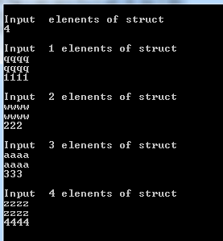

Slide 9
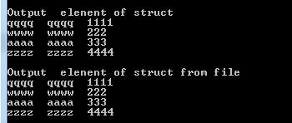

Slide 10
